Slide 1
Natural Language Processing with Attention Models
17/04/2024

Slide 2
Course Overview
This course is designed for everyone, including professionals, executives, students, and enthusiasts, interested in learning about generative AI and leveraging its capabilities in their work and lives.
This course is your first step toward understanding the capabilities of generative AI, powered by different models, including large language models.

Slide 3
Topics
NLP
RNN
LSTM
Transformers

Slide 4
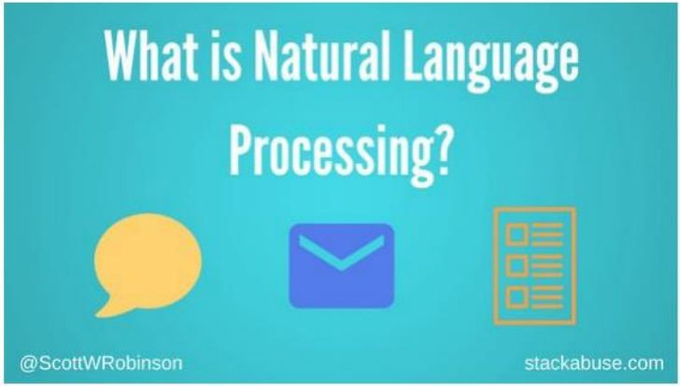
What is NLP?
Natural Language => Means/Media of Communication between Humans:
-Verbal □Speech
-Textual
-Sometimes: Visual(Visual QA, OCR)

Slide 5
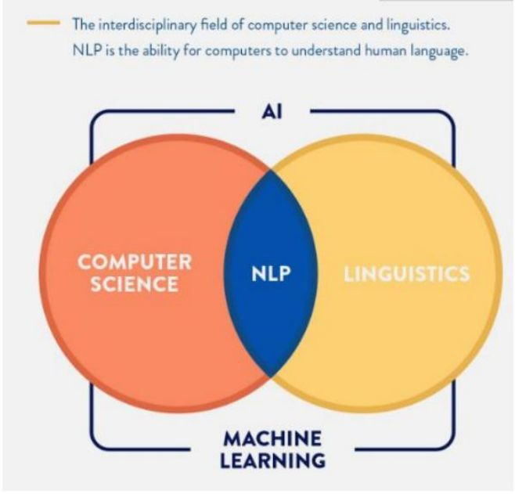
What is NLP?
How to make language understandable to computers?
Then develop algorithms to operate on the input language:
CS
AI
Linguistics

Slide 6
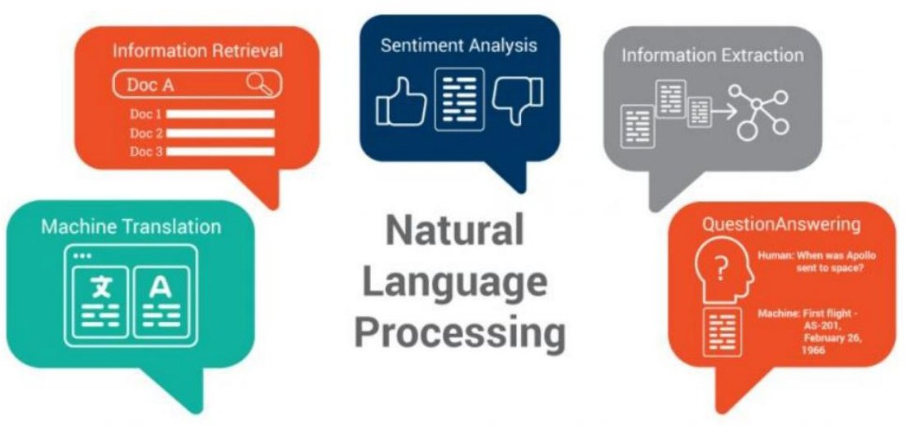
Why NLP?

Slide 7
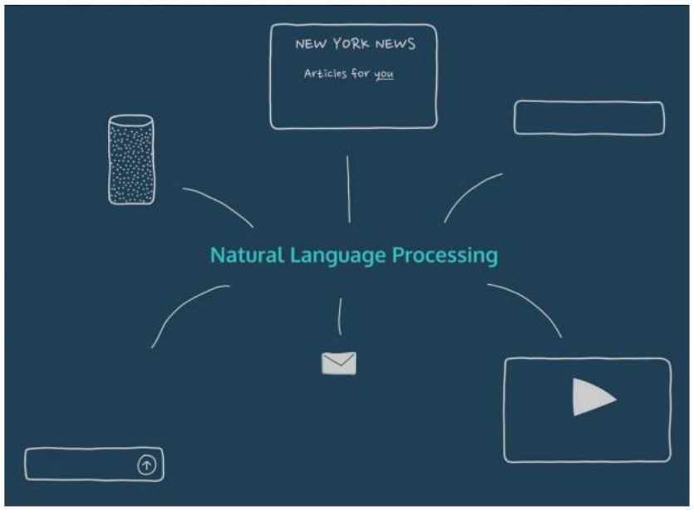
Human-M achine Interactio ns

Slide 8
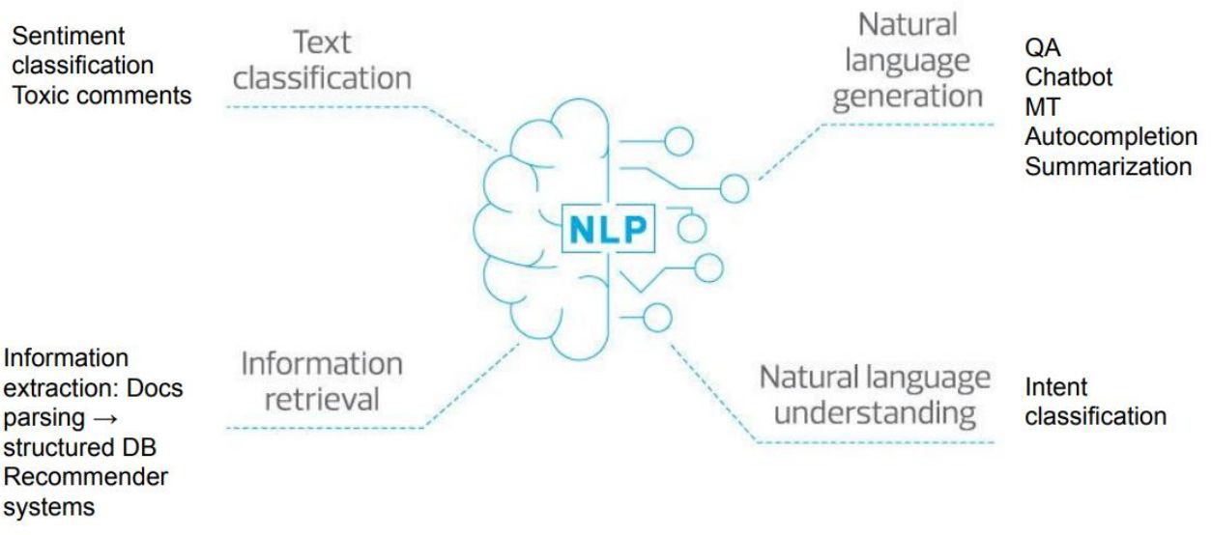
What are NLP tasks?

Slide 9
Why NLP is hard?
Human Language is difficult
Symbolic
Implicit (Sarcasm!)
Different Encodings for the same symbol meaning:
- Could include other signals(gestures, emoticons, speech)
Sparse: large vocab
Diverse: many languages, dialects, accents, …etc

Slide 10
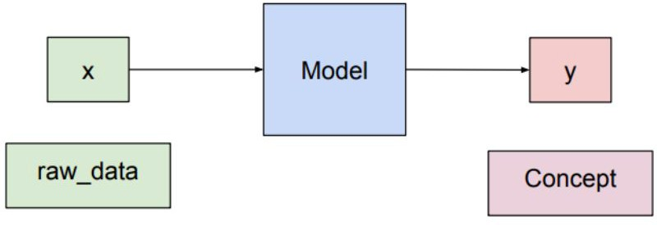
Semantic gap in ML

Slide 11
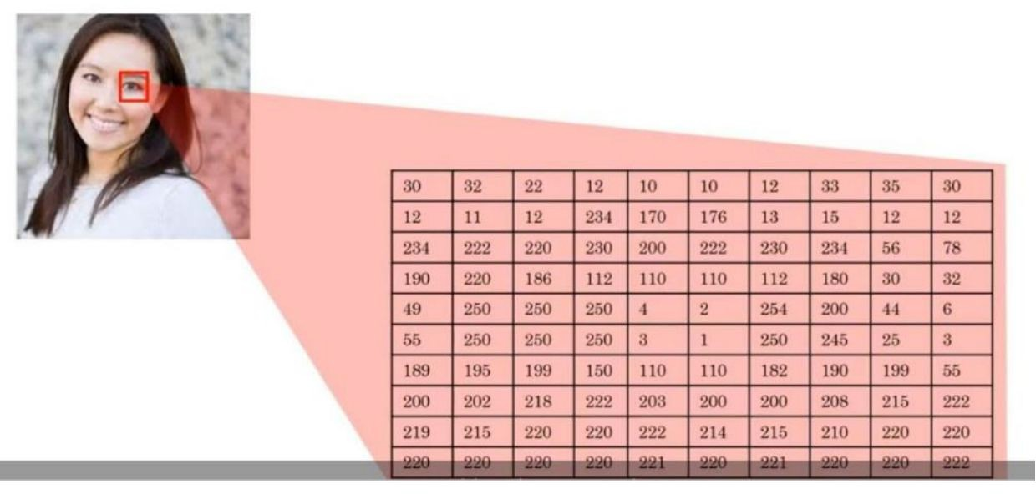
Semantic gap in ML
CV: What the computer can see?

Slide 12
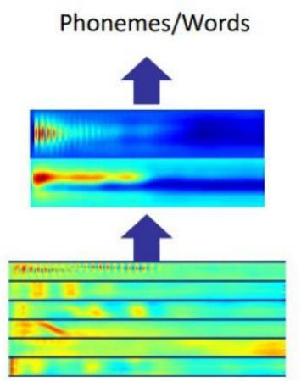
Semantic gap in Speech

Slide 13
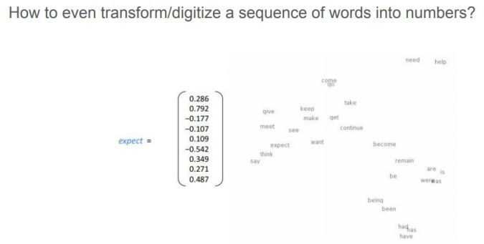
Semantic gap in Text

Slide 14
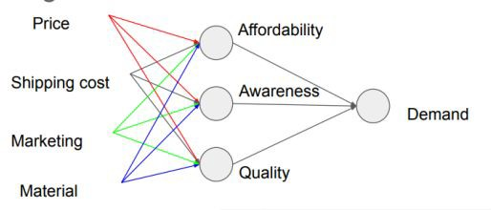
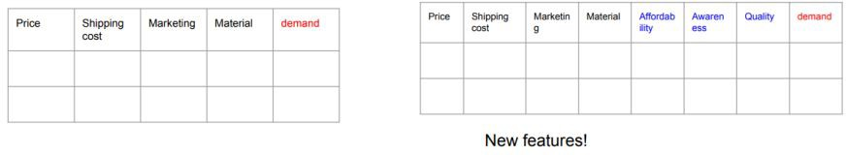
DL way of thinking □ Hierarchical refinement of concepts

Slide 15
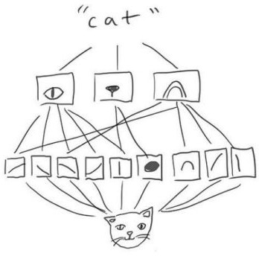
DL way of thinking □ Hierarchical refinement of concepts

Slide 16
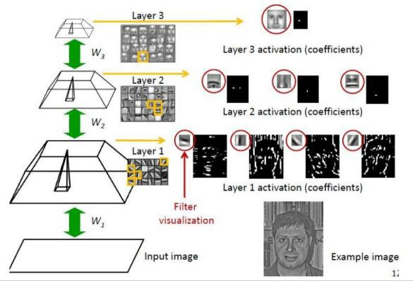
CV is spatial

Slide 17
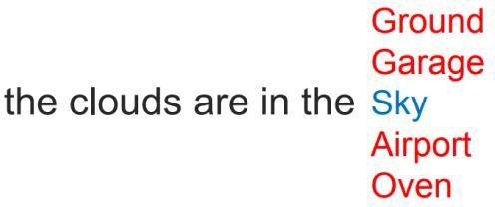
NLP is sequential

Slide 18
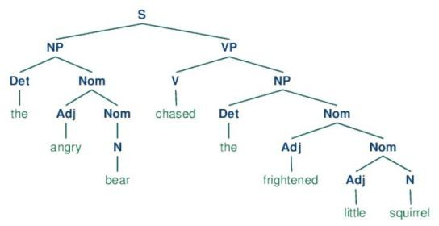
NLP is hierarchical

Slide 19
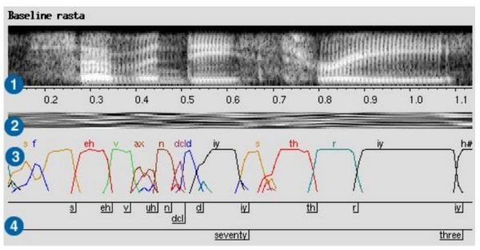
NLP is sequential

Slide 20
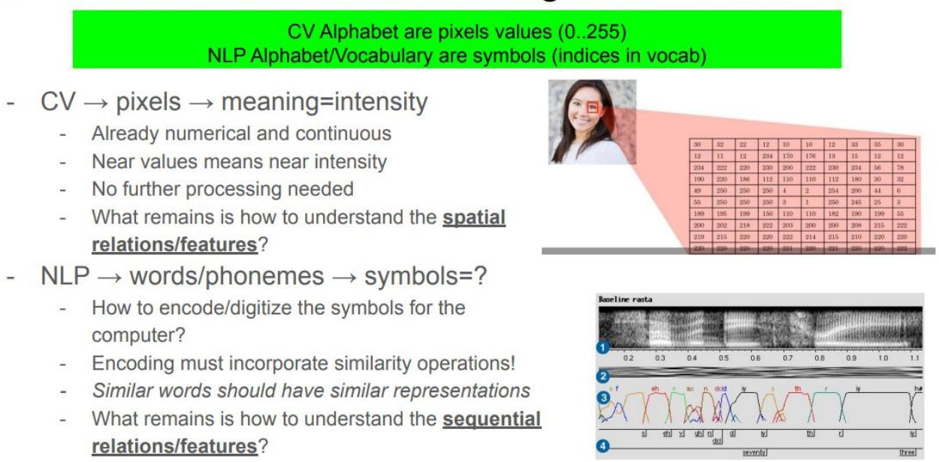
CV is continuous – NLP is categorical

Slide 21
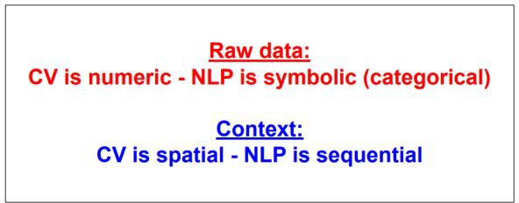
Analogy CV vs NLP - conclusion

Slide 22
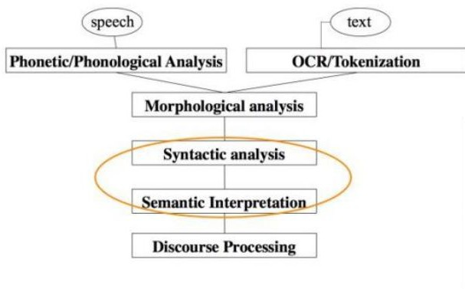
NLP pipeline
Low level tasks □ Medium dependent NLP Levels
(speech,text, ..etc)
Morphology: Normalize symbols variations (synonyms, phonemes,…etc)
Syntax: Parse symbols according to some template □ “grammar”
Semantics: Convert symbols to meaningful structures
Processing: Perform the task!

Slide 23
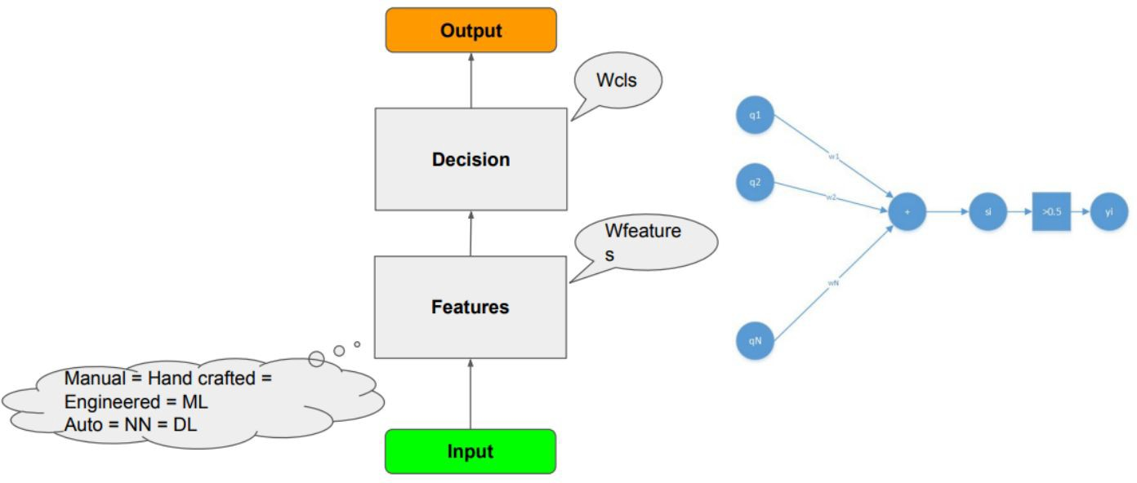
Supervised Learning Model Design Pattern

Slide 24
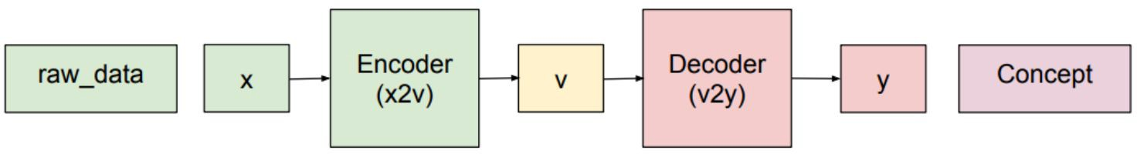
Encoder-Decoder to close the semantic gap in ML

Slide 25
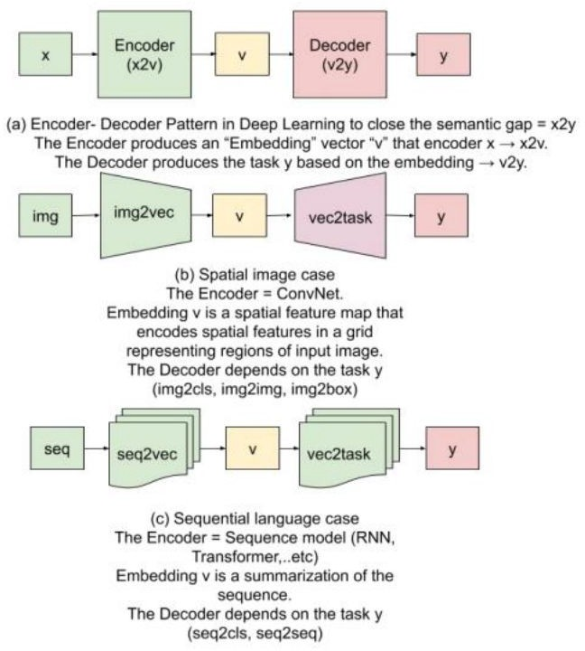
Encoder-Decoder pattern in NLP

Slide 26
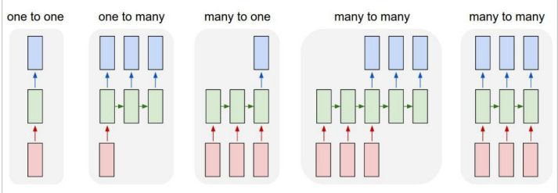
Encoder-Decoder pattern

Slide 27
Examples
One-One: Vanilla mode of processing without RNN, from fixed-sized input to fixed-sized output (e.g. image classification)
One-many: Sequence output (e.g. image captioning takes an image and outputs a sentence of words)
Many-one: Sequence input (e.g. sentiment analysis where a given sentence is classified as expressing positive or negative sentiment)
Many-Many: Sequence input and sequence output (e.g. Machine Translation: an RNN reads a sentence in English and then outputs a sentence in French)
Synced sequence input and output: NER

Slide 28
Q&A
Questions and answers

Slide 29
What is the best representation of language?
This question summarizes all NLP efforts! For what?
Classification
Many-to-one: Seq2Class
Sentiment analysis, Toxicity detection (JIGSAW), Real or not? Disaster tweets
Dialogue:
Many-to-many: Seq2Seq □ Unaligned case □More on that later
MT, Spelling correction, Speech, OCR, …etc

Slide 30
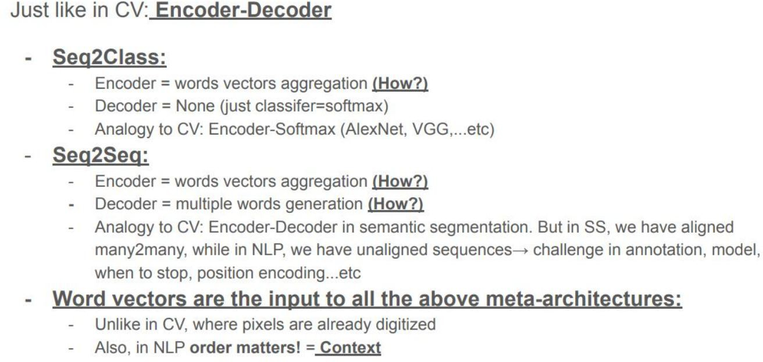
NLP models meta-architectures

Slide 31
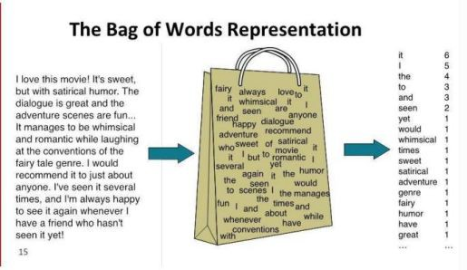
How to represent words to NN?
If we use Dense layers, we need fixed-sized input vectors
Words = Symbols
The alphabet of symbols is the vocabulary
For each piece of text □ Put in the bag what is in the text

Slide 32
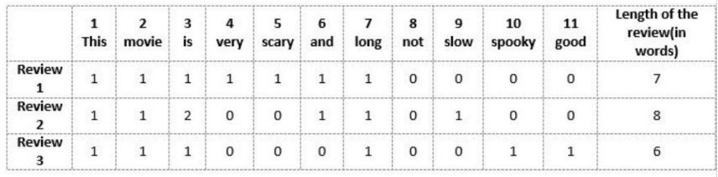
How to represent words to NN?
Bag-of-Words model

Slide 33
Text pre-processing pipeline

Slide 34

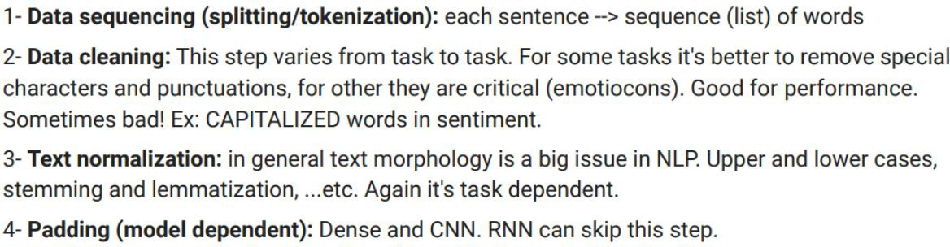

Two Phases
A-Text Preprocessing
B-Text Preparation

Slide 35
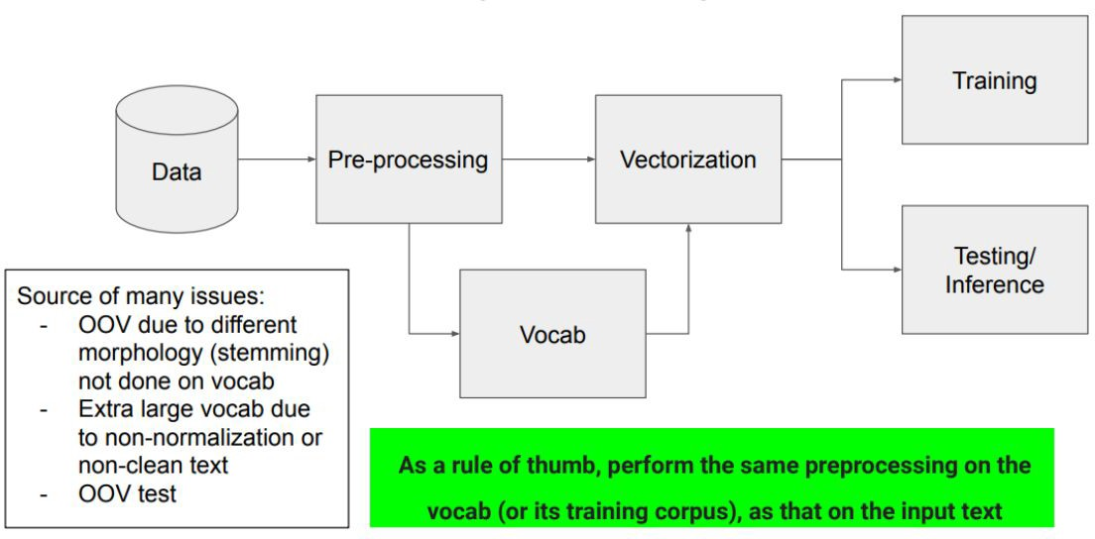
Same pre-processing in training and inference

Slide 36
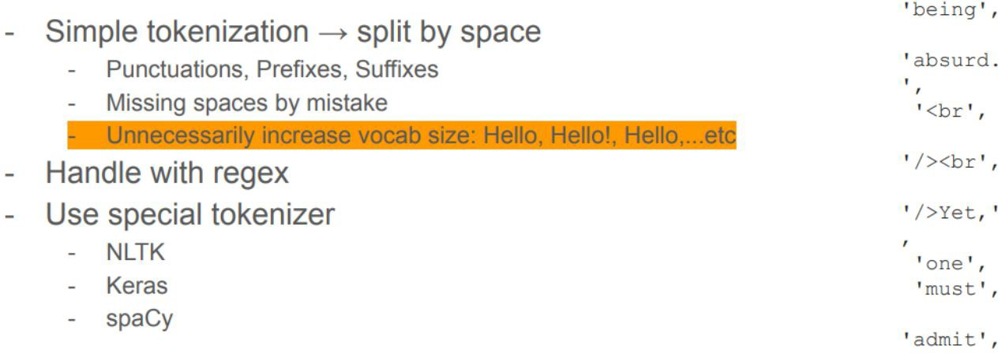
Sequencing and Tokenization

Slide 37
Normalization
Case-normalization
Less vocab □ Hello, hello, HELLO □ hello
Hence, reduce OOV
Could remove some meaning □ WHAT!
Remove stop words
Again reduces vocab
But could remove some meaning □ with context and co-reference □ No need with sequence models and DL

Slide 38
Tokenization
Tokenization is one of the most common tasks when it comes to working with text data
Tokenization is essentially splitting a phrase, sentence, paragraph, or an entire text document into smaller units, such as individual words or terms. Each of these smaller units are called tokens.
It is important because the meaning of the text could easily be interpreted by analyzing the words present in the text.
Methods to Perform Tokenization in Python :
Tokenization using Python’s split() function
Tokenization using Regular Expressions (RegEx)
Tokenization using NLTK
Tokenization using the other libraries like spaCy and Gensim library
The final Goal of Tokenization is : Creating Vocabulary

Slide 39
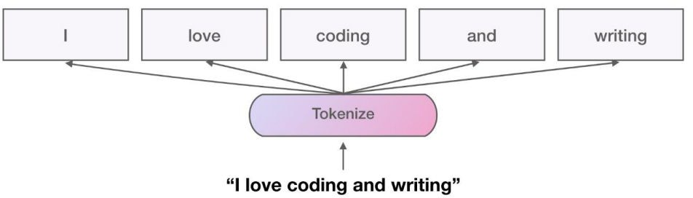
Tokenization

Slide 40
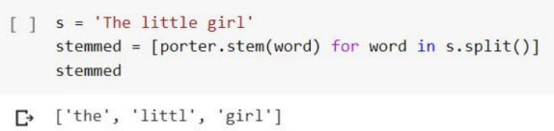
Stemming
Another source of redundancy and highly variable/unexpected morphology are the prefixes and suffixes
The most basic ones trims prefixes and suffixes, known in the language
Note that: stemming might produce meaningless words sometimes!
Also, notice how stemming automatically reduce to lower case.
If we are going to preprocess with stemming, we must do the same on the text we use for building our vocab!
AS a rule of thumb, perform the same preprocessing on the vocab(or its training corpus), as that on the input text

Slide 41
Lemmatization
Unlike stemming, lemmatization understand the root of the word in the language:
(am, is, are □ Be)
So not only the morphology is considered, but also the root. This has more importance in languages like Arabic (requires special lemmatizers and stemmers)
Either stem or lemmatize There’s no need to do both.
Actually stemming might make lemmatization not working

Slide 42
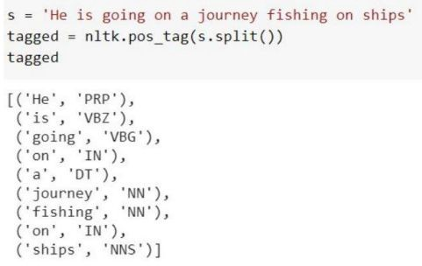
PoS Tags
In NLP, Part-of-Speech refers to the different classes a word can belong to:
Noun, Verb, Adjective, …etc.
The different tags/classes are called tagset, and there’s no common standard.
They usually encode grammar + tense.
The task of PoS tagging resembles the task of semantic segmentation in CV; assign a class for every word

Slide 43
Extra clean-up
We might encounter non ascii codes. In this case we need to decode Unicode characters into a normalized form, such as UTF8

Slide 44
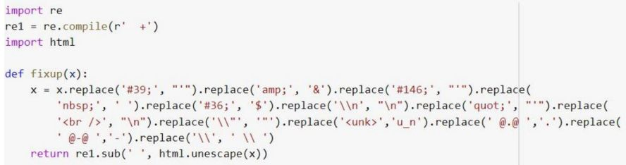
Extra clean-up
We might encounter non ascii codes. In this case we need to decode Unicode characters into a normalized form, such as UTF8
Remove special characters

Slide 45
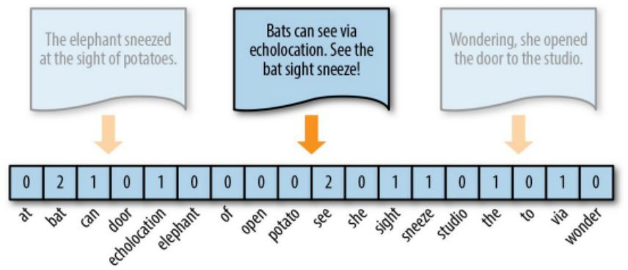
Vectorization
Build vocab
Register the index of the word from the vocab
Not in vocab? □ store as UNK
Need to pad? □ encode as PAD
All special tokens must NOT be used for other symbols
Example: if PAD=0, don’t use 0 as a word index (known mistake)
Manual or Tokenizer
Most tokenizers do both: splitting + vectorization

Slide 46
Vectorizing
Vectorizing : The process that we use to convert text to a form that Python and a machine learning model can understand
It is defined as the process of encoding text as integers to create feature vectors
A feature vector is an n-dimensional vector of numerical features that represent some object
So in our context, that means we'll be taking
- an individual text message and converting it to a numeric vector that represents that text message

Slide 47
Vectorizing
There are many vectorization techniques, we will focus on the three widely used vectorization techniques:
Count vectorization
N-Grams.
Term frequency - inverse document frequency (TF-IDF)
These methods will generate very similar document-term matrices where there's one line per document(SMS in our case,then the columns will represent each word or potentially a combination of words
The main difference between the three is what's in the actual cells of the matrix

Slide 48
1- Count vectorization
Count Vectorizer: The most straightforward one, it counts the number of times a token shows up in the document and uses this value as its weight.
We will create a matrix that only has numeric entries counting how many times each word appears in each text message. The machine learning algorithm understands these counts. So if it sees a one or a two or a three in a cell, then that model can start to correlate that with whatever we're trying to predict
A document term matrix is generated where each cell is the count corresponding to the message type indicating the number of times a word appears in a document, also known as the term frequency
The document term matrix is a set of dummy variables that indicates if a particular word appears in the document. A column is dedicated to each word in the corpus.

Slide 49
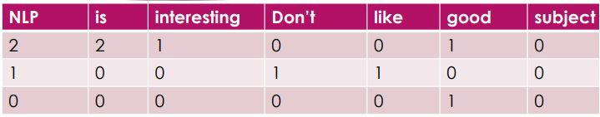
1- Count vectorization- Document term matrix
This means, if a particular word appears many times in spam or ham message
,then the particular word has a high predictive power of determining if the message is a spam or ham .
NLP is interesting , NLP is good
Don’t like NLP
good subject

Slide 50
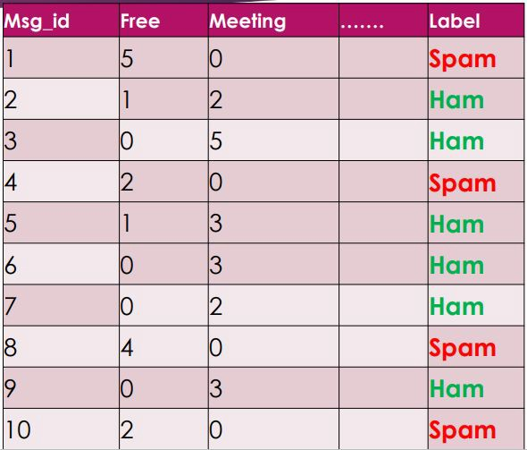
1- Count vectorization- Document term matrix
If we select only 10 messages and assume that we have 200 unique words
The final result will be like this
10 rows with 200 columns
In our case , we have 5568 message * unique words

Slide 51
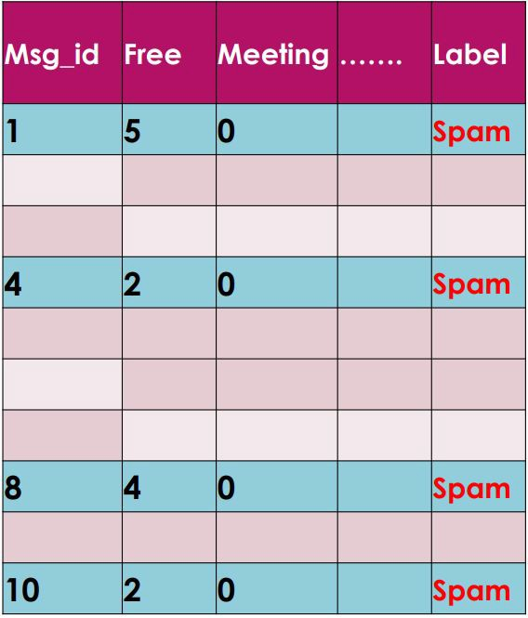
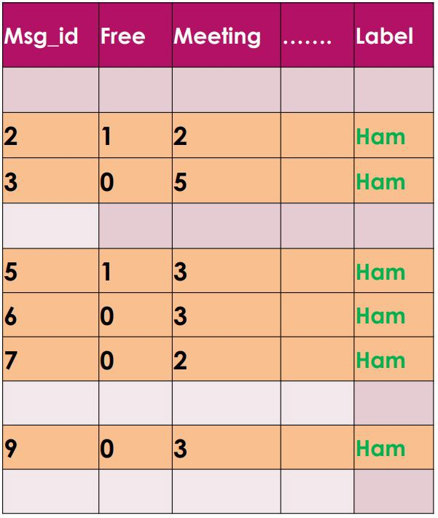
1- Count vectorization- Document term matrix

Slide 52
1- Count vectorization- Document term matrix
If we select only 10 messages and assume that we have 200 unique words
The final result will be like this 10 rows with 200 columns
In our case , we have 5568 message * unique words

Slide 53
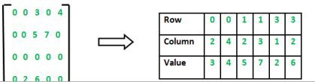
Sparse Matrix
when you have a matrix in which a very high percent of the entries are zero, instead of storing all these zeros in the full matrix, which would make it extremely inefficient, it'll just be converted to only storing the locations and the values of the non-zero elements, which is much more efficient for storage.
Sparse Matrix: A matrix in which most entries are 0. In the interest of efficient storage, a sparse matrix will be stored by only storing the locations of the non-zero elements.
Why to use Sparse Matrix instead of simple matrix ?
Storage: There are lesser non-zero elements than zeros and thus lesser memory can be used to store only those elements.
Computing time: Computing time can be saved by logically designing a data structure traversing only non-zero elements..

Slide 54
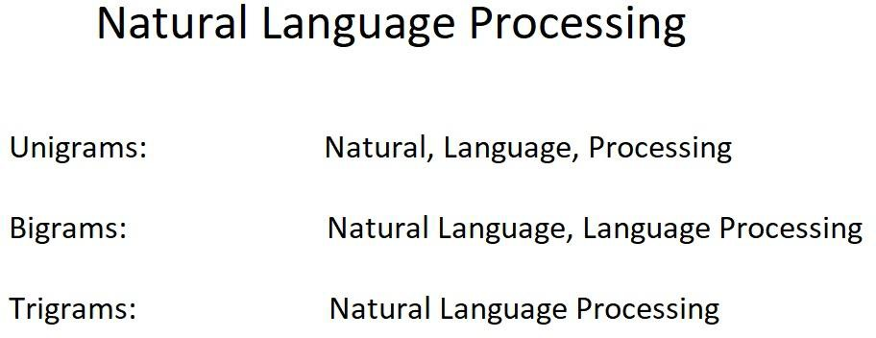
N-gram vectorizing
The n-grams process creates a document-term matrix like we saw before. Now we still have one row per text message and we still have counts that occupy the individual cells but instead of the columns representing single terms ,here ;all combinations of adjacent words of length and in your text.
As an example, let's use the string Natural Language Processing.

Slide 55
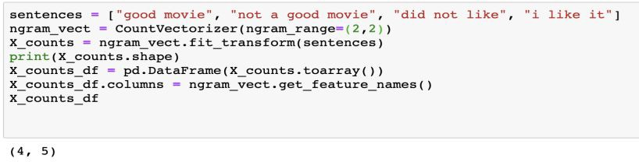
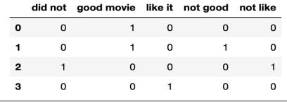
N-gram vectorizing(2,2)

Slide 56
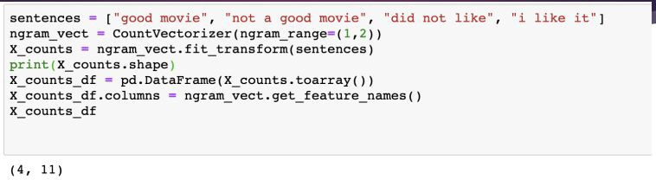
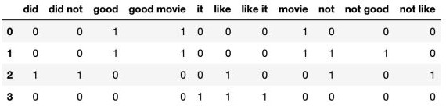
N-gram vectorizing(1,2)

Slide 57
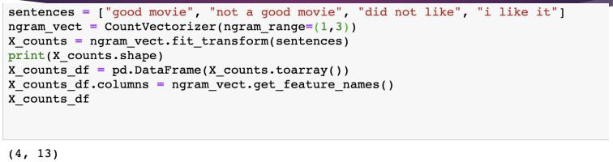
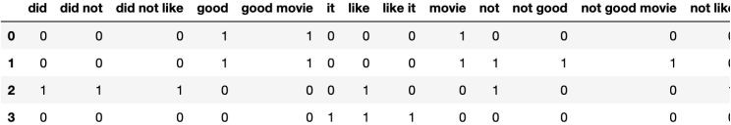
N-gram vectorizing(1,3)

Slide 58
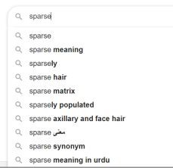
N-gram vectorizing
When you use n-grams there's usually an optimal n value or range that will yield the best performance
The intuition here is that bi-grams and tri-grams can capture contextual information compared to just unigrams. Rather than only seeing one word at a time
The trade-off is between the number of N values. Choosing a smaller N value, may not be sufficient enough to provide the most useful information. Whereas choosing a high N value, will yield a huge matrix with loads of features. N-gram may be powerful, but it needs a little more care
Google's auto complete uses an n-grams like approach, try to type and test.

Slide 59
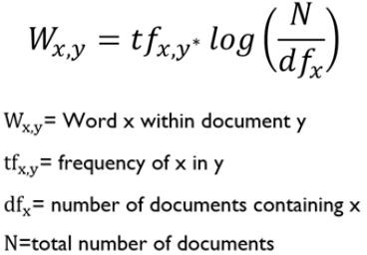
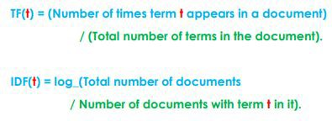
Term frequency - inverse document frequency (TF-IDF)
TF-IDF creates a document term matrix, where there's still one row per text message and the columns still represent single unique terms.
But instead of the cells representing the count, the cells represent a weighting that's meant to identify how important a word is to an individual text message.
This formula lays out how this weighting is determined.
weighting = TF*IDF

Slide 60
TF-IDF- How to Compute:
Typically, the TF-IDF weight is composed by two terms:
Term Frequency (TF), the number of times a word appears in a document, divided by the total number of words in that document. Since every document is different in length, it is possible that a term would appear much more times in long documents than shorter ones. Thus, the term frequency is often divided by the document length ( the total number of terms in the document) as a way of normalization:
Inverse Document Frequency (IDF), computed as the logarithm of the number of the documents in the corpus divided by the number of documents where the specific term appears. However it is known that certain terms, such as "is", "of", and "that", may appear a lot of times but have little importance. Thus we need to weigh down the frequent terms while scale up the rare ones, by computing the following:

Slide 61
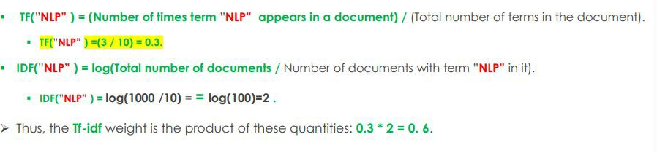
TF-IDF- How to Compute:
Example:

Slide 62


TF-IDF- Vs N-Gram:

Slide 63
Q&A
Questions and answers

Slide 64
Email/SMS Spam Filtering Notebook

Slide 65

Recurrent Neural Networks (RNN)
It's used with sequential data, and it's based on the element of time, like stock prices or weather data, also the texts, because “she spoke to her husband”, ‘her’ word depends on ‘she’, and all it knows is that it treats like it has a memory that depends on it.
The structure is as follows:
Where the network uses the output as an input again.

Slide 66

RNN has a relationship with DNN design because in DNN, if we rotate it, compress the cells, and then repeat it, it turns into RNN.

Slide 67

RNN has two major disadvantages

Slide 68


Recurrent Neural Networks (RNN)

Slide 69

RNN training
Back-propagation over time

Slide 70
Vanishing Gradients
For the traditional activation functions, each gradient term has the value in range (-1, 1).
Multiplying n of these small numbers to compute gradients
The longer the sequence is, the more severe the problems are.

Slide 71
RNNs characteristics
Model hidden states (input) dependencies
Errors “back propagation over time”
Feature learning methods
Vanishing gradient problem:
cannot model long-distant dependencies of the hidden states.

Slide 72


Long Short-Term Memory (LSTM)
Use gates to control the information to be added from the
input, forgot from the previous memories, and outputted.
σ and f are sigmoid and tanh function respectively, to map the value to [-1, 1]

Slide 73


The basic difference between the function of tanh, sigmoid is the range.

Slide 74

In the first part, we see the sigma mark σ, which represents the gates that control the flow of data, and they control the amount of data that comes in from the old memory that comes from the former output, and if it's 0, 1, or 0.5, it controls this amount of data.

Slide 75

The next cell controls the amount of data that will be added to the next one, and it has values of 0 is 1 or 0.5 that indicate the amount of addition.

Slide 76

In cell number three, it's the one who's taking the data into it and making the new memory.

Slide 77

And then we design the new memory of the cell with this equation.

Slide 78

The next step is controlling the amount of output from the cell.

Slide 79

Then process and produce the output itself with the tanh equation

Slide 80

Long Short-Term Memory (LSTM)

Slide 81

Simple RNN vs LSTM
LSTM is even more slower to train as compared to RNN
Vanishing gradient problem still persists
Sequential computation inhibits parallelization
Distance between positions is linear

Slide 82
Transformers

Slide 83

Deep learning for NLP

Slide 84


Slide 85
Models
Neural Networks
Recurrent Neural Networks
Encoder-Decoder
Attention Models
Transformer

Slide 86
Models with application
Neural Networks - Word representation (word2vec)
Recurrent Neural Networks - Language Generation
Encoder-Decoder - Translation
Attention Models - Translation, Image recognition
Transformer - Translation

Slide 87
Q&A
Questions and answers

Slide 88
Model 1 Neural Networks

Slide 89

Neural Network
Neural Networks act as a ‘black box’ that takes inputs and predicts an output

Slide 90

Neural Network

Slide 91

Neural Network

Slide 92

Neural Network

Slide 93

Neural Network
‘Black box’ that takes inputs and predicts an output.
Trained using known (input, output), approximates the function and maps new inputs.
Learns the function mapping inputs to output by adjusting the internal parameters (weights)

Slide 94

Word2vec using neural networks

Slide 95

Word2vec using neural networks

Slide 96

Word2vec using neural networks

Slide 97
From words to sentences
Word embedding captures meaning of words
How about sentences?
Can we encode meaning of sentences
□You can’t cram the meaning of the entire $%!!* sentence into a !!$!$ vector
Sentences are variable length
□Need fixed length representation

Slide 98
Model 2 RNN

Slide 99
RNN
RNNs are used when the inputs have some state information
Examples include time series and word sequences
Can captures the essence of the sequence in its hidden state (context)

Slide 100

RNN – unrolled in time

Slide 101

RNN

Slide 102

RNN

Slide 103

RNN can learn sentence representation

Slide 104

RNN can predict

Slide 105

RNN Training

Slide 106
RNN - Summary
RNN can encode sentence meaning
Can predict next word given a sequence of words Can be trained to learn a language model

Slide 107
RNN - Problems
Hard to parallelize efficiently
Back propagation through variable length sequence
Transmitting information through one bottleneck (final hidden state)
Longer sentences lose context
□Example: I was born in France .. I speak fluent French
(There are improvements to RNN structure that retain context)

Slide 108

Translation – First Attempt
Now we can have two RNNs jointly trained
The first RNN creates context
The second RNN uses the final context of the first RNN
Training using Parallel corpora

Slide 109
Model 3 Encoder Decoder

Slide 110

Encoder Decoder

Slide 111

Encoder Decoder

Slide 112

Encoder Decoder

Slide 113

Encoder Decoder in Translation

Slide 114
Encoder - Decoder Summary
2014 – Google replaced their Statistical model with NMT
Due to its flexibility it is the go to framework for NLG with different models taking roles of encoder and decoder
The decoder can not only be conditioned on a sequence but on arbitrary representation enabling lot of use cases (Like generating caption from image)

Slide 115
Translation using Encoder - Decoder
Issues
Meaning is crammed
Long term dependencies
Word alignment
Word interdependencies

Slide 116
Translation issues (long term dependencies)
The model can not remember enough
Only final Encoder state is used
Each encoder state has valuable information Difficult to retain > 30 words
“Born in France .. Went to EPFL Switzerland .. I speak fluent ..”

Slide 117

Translation issues (Word alignment)

Slide 118

Translation issues (Word alignment)

Slide 119


Slide 120

Translation issues (Interdependencies)

Slide 121
Translation issues
Interdependencies
Crammed meaning (due to context) Word alignment
Words may or may not compose (green apple, hot dog) Word ordering is important (I hit him on the eye yesterday)

Slide 122
How to retain more meaning (Context)
Decoding is done using only final context
The final context doesn’t capture entire information
Can we use intermediate contexts?

Slide 123
Model 4 Attention

Slide 124
Need for Attention
Attention removes bottleneck of Encoder-Decoder model
Pay selective attention to relevant parts of input
Utilize all intermediate states while decoding
(Don’t encode the whole input into one vector losing information )
Do Alignment while translating

Slide 125

Pay selective attention

Slide 126

Pay selective attention

Slide 127

Without attention

Slide 128

Attention

Slide 129

Attention captures alignment

Slide 130
Attention Summary
Pay selective attention to words we need to translate
Compute weighted sum of all hidden states (called attention weight)
Use attention weights while decoding Attention also take care of alignment

Slide 131
Model 5 Transformers

Slide 132
Transformers
Can we get rid of RNN completely?
RNN are too sequential
Parallelization is not possible since these intermediate contexts are generated sequentially

Slide 133

Transformers

Slide 134

Transformers

Slide 135
Transformers
There are three kinds of attention
Within encoder
Encoder decoder
Within decoder

Slide 136

Transformers (Self attention)

Slide 137

Transformers (Self attention)

Slide 138
Transformers (Self attention)
Remember that Encoder creates input representation
Transformers create a rich representation that captures interdependencies
(This rich representation captures relationship between words compared to simple word embeddings)
This rich representation is called Self-attention

Slide 139

Transformers (Self attention)
Self attention mechanism directly models relationships between all words in a sentence, regardless of their respective position
Self attention allows connections between words within a sentence Eg. I arrived at the bank after crossing the river

Slide 140
Transformers
Use self attention instead of RNNs, CNN
Computation can be parallelized Ability to learn long term dependencies

Slide 141

Transformers

Slide 142

Transformers model

Slide 143

Transformers
Fig. Unfolded network architecture of the transformer

Slide 144

Two types of attention
Source Target Attention
Self Attention
What is the difference?
□Depends on where query comes from Query from Encoder □ Self-Att.
Query from Decoder □ Source-Target Att.

Slide 145

Entire Model Architecture
Left side: Encoder
Right side: Decoder
Consisting Layers:
Multi-Head Attention Layer
Position-wise Feed-Forward layer
Positional Encoding
(Residual Adding and Normalization Layer)

Slide 146



Attentions

Slide 147

What is Attention?

Slide 148


Slide 149


Slide 150



Slide 151



Slide 152


Slide 153


Slide 154
Q&A
Questions and answers

Slide 155
Thanks

